Slide 1
What is Agile?
Agile is a Project Management and software development approach that aims to be more effective.
It focuses on delivering smaller pieces of work regularly instead of one big launch.
This allows teams to adapt to changes quickly and provide customer value faster.
Types of Agile Methodology:-
Following are the types of Agile methodology:
Kanban
Scrum
Lean
DSDM or Dynamic Systems Development Method ·
XP or Extreme Programming
FDD or Feature Driven Development
Crystal
Scaled Agile Framework (SAFe)

Slide 2
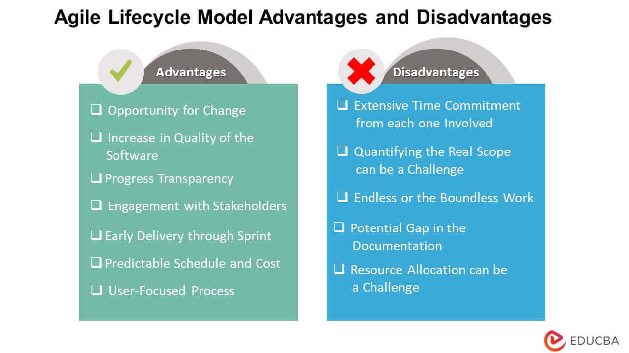

Slide 3
Agile | Waterfall
.Client input is required throughout the product development. | Client input is required only after completing each phase.
Changes can be made at any stage | Changes cannot be made after the completion of a phase.
A Small team is sufficient for Agile project management. | It requires a large team.
Coordination among project teams is required to ensure correctness. | Coordination is not needed as one team starts the work after the finish of another team.
It is really useful in large and complex projects. | It is mainly used for small project development.
The testing part can be started before the development of the entire product. | Testing can only be performed when the complete product is ready.
The cost of development is less. | The cost of development is high.

Slide 4
